Slide 1
5 questions
What is the size of angle f?
Simplify the ratio 25:45
Find the area of the triangle below
If I double the lengths on the sides of the rectangle, will the area double?
Complete your summary and make sure your contents page is up to date.
fº
43º
15º
7cm
12 cm
4cm
5cm

Slide 2
Corresponding angles are the pairs
of equal angles which are formed
when two parallel lines are cut by
a single straight line.

Slide 3
125º
a
b
d
c
Which angle is corresponding to 125º.

Slide 4
Which angle is corresponding to 32°.
32°
a
d
b
c

Slide 5
d
a
c
b
48º
Which angle is corresponding to 48°.

Slide 6
Alternate angles are on the opposite side
and at opposite ends of a line that cuts a
pair of parallel lines.

Slide 7
130º
a
b
d
c
Which angle is alternate to 130º.

Slide 8
Which angle is alternate to 60º.
a
b
d
c
60º

Slide 9
c
b
135°
a
45°
straight line with 135°.
a = ……… because …………………………………………………
45°
alternate with angle a.
b = ……… because …………………………………………………
135°
straight line with b.
corresponding with 135°.
c = ……… because …………………………………………………

Slide 10
D
y
72°
x
46°
A
B
C
62°
third angle in triangle = 62°
x = ……… because …………………………………………………
and x is on a straight line with this angle.
…………………………………………………………………………………
46°
corresponding with 46°.
y = ……… because …………………………………………………
…………………………………………………………………………………

Slide 11
115°
124°
65°
x
124°
fourth angle in the quadrilateral
x = ……… because …………………………………………………………
= 56° and x is on a straight line with this angle.
……………………………………………………………………………………………
Is AC parallel to E.
yes
x and 124° are alternate.
……… because …………………………………………………………………
…………………………………………………………………………………………

Slide 12
corresponding, alternate or neither.
a
b
d
c
h
e
g
f
2. f + c.
3. c + h.
4. a + g.
1. e + d.
5. b + e

Slide 13
corresponding, alternate or neither.
u
r
3. r + y
4. x + s
5. w + u
2. s + z
1. t + y
t
s
z
w
y
x

Slide 14
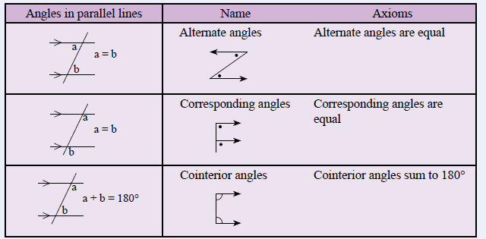
24
7
30
Topic : Angles and Parallel lines
Date
EQ - What are the names of the three sets of angles found in parallel lines
Within parallel lines there are three types of angle relationships

Slide 15
24
7
30
Topic : Angles and Parallel lines
Date
EQ - What are the names of the three sets of angles found in parallel lines
Within parallel lines there are three types of angle relationships
Have a “Z” Shape

Slide 16
24
7
30
Topic : Angles and Parallel lines
Date
EQ - What are the names of the three sets of angles found in parallel lines
Within parallel lines there are three types of angle relationships
Have a “Z” Shape
Have an “F” Shape

Slide 17
24
7
30
Topic : Angles and Parallel lines
Date
EQ - What are the names of the three sets of angles found in parallel lines
Within parallel lines there are three types of angle relationships
Have a “Z” Shape
Have an “F” Shape
Have a “C” Shape

Slide 18

Name The Relationship
1.
2.
3.
4.
5.
6.
7.
8.
9.
10.
11.
12.
13.
14.
15.
16.
Notes:
Surfing the web

Slide 19

Find the Angle size
1.
2.
3.
130°
x
140°
x
x
125°
4.
5.
6.
72°
x
x
82°
37°
x
7.
8.
9.
45°
x
x
65°
x
142°
105°
Notes:
Apple pie

